Slide 1
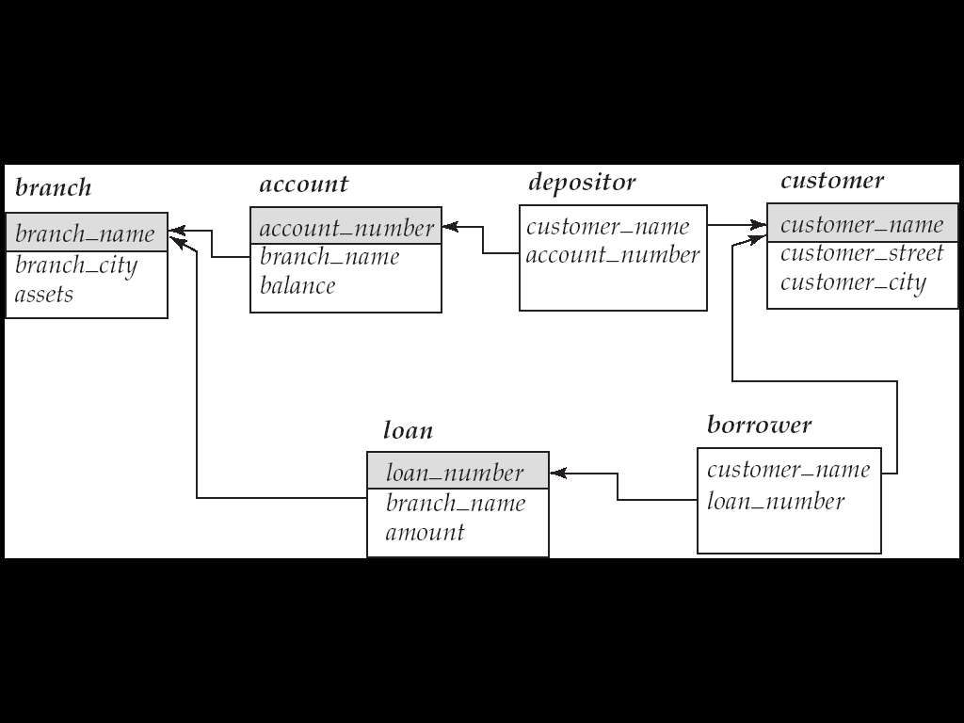

Slide 2
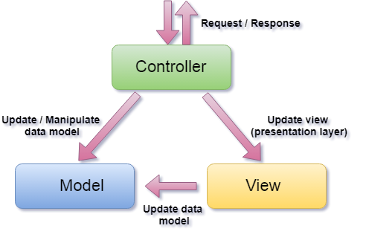
Example: Web Applications MVC framework

Slide 3
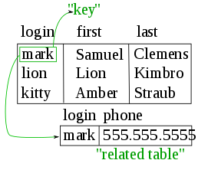
In the DBs, data records are "linked" using “virtual keys”. These “links” are not stored in the database but defined as needed between the data.
Pe’er
Pe’er

Slide 4
OUTLINE
CENG 3005 Database Management Systems Week 7
SQL
Ordering
Set Operations
Inner Join/Left Outer Join/Right Outer Join/Full Join
Aggregate Functions
Modifying the database (Delete/Insert/Update)
Views
Stored procedures
Functional Dependencies
Normal Forms

Slide 5
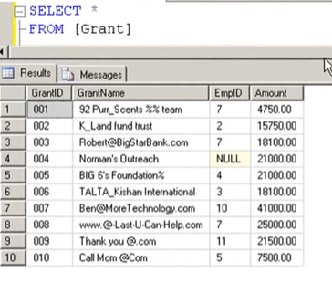
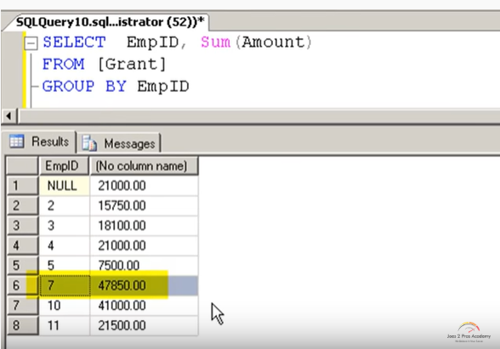
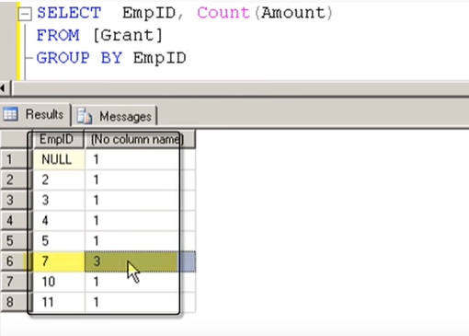

Slide 6
OUTLINE
SQL
Ordering
Set Operations
Inner Join/Left Outer Join/Right Outer Join/Full Join
Aggregate Functions
Modifying the database (Delete/Insert/Update)
Views
Stored procedures
Functional Dependencies
Normal Forms

Slide 7
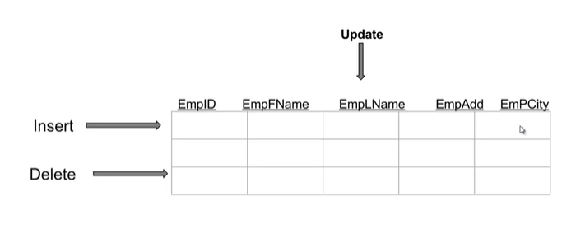
Modifying the Database

Slide 8
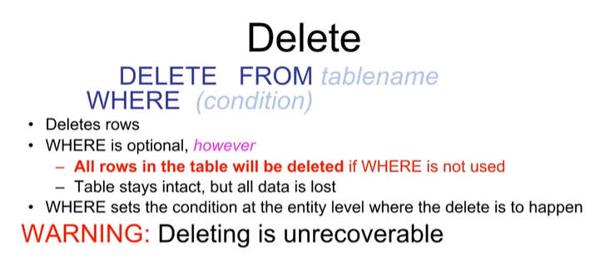

Slide 9
Modification of the Database – Insertion one row at a time
Add a new tuple to account
insert into account values ('A-9732', 'Perryridge', 1200)
or equivalently
insert into account (branch_name, balance, account_number) values ('Perryridge', 1200, 'A-9732')
Add a new tuple to account with balance set to null
insert into account values ('A-777','Perryridge', null )

Slide 10
Modification of the Database – Insertion : multiple rows at a time
Provide as a gift for all loan customers of the Perryridge branch, a $200 savings account. Let the loan number serve as the account number for the new savings account
insert into account select loan_number, branch_name, 200 from loan where branch_name = 'Perryridge' insert into depositor select customer_name, loan_number from loan, borrower where branch_name = 'Perryridge' and loan.account_number = borrower.account_number
The select from where statement is evaluated fully before any of its results are inserted into the relation
Motivation: insert into table1 select * from table1

Slide 11
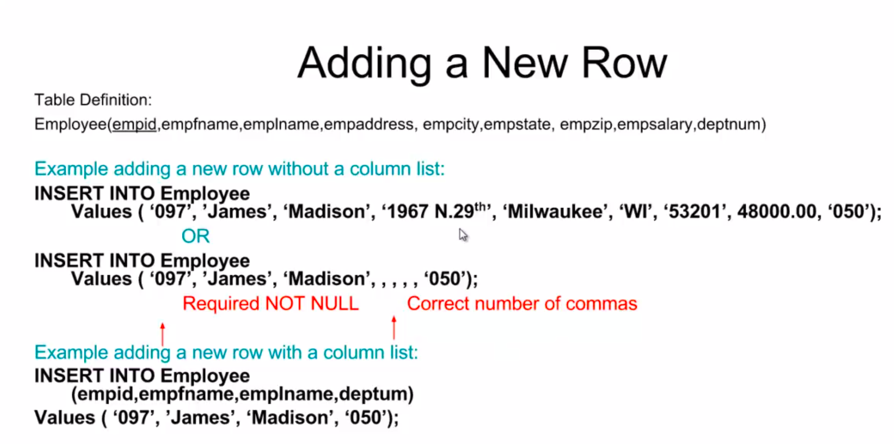

Slide 12
Modification of the Database – Updates
Increase all accounts with balances over $10,000 by 6%, all other accounts receive 5%.
Write two update statements:
update account set balance = balance ∗ 1.06 where balance > 10000
update account set balance = balance ∗ 1.05 where balance ≤ 10000
The order of these two SQLs is important!!

Slide 13
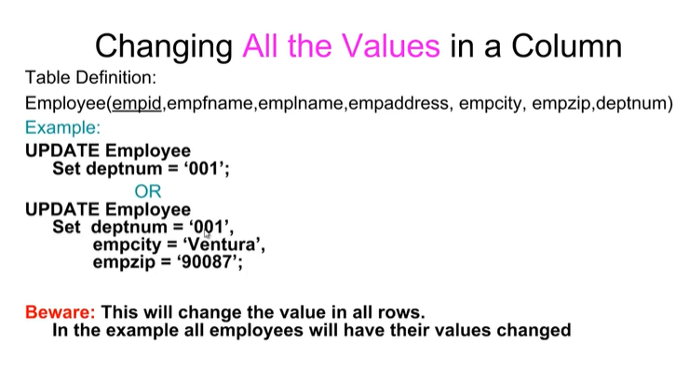
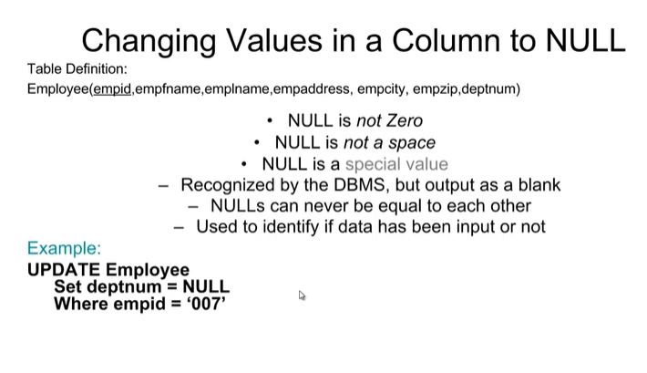
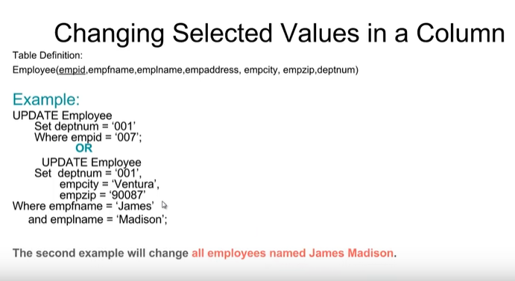

Slide 14
Nested Subqueries
SQL provides a mechanism for the nesting of subqueries.
A subquery is a select-from-where expression that is nested within another query.
A common use of subqueries is to perform tests for
set membership
set comparisons
set cardinality.

Slide 15
“In” Construct
Find all customers who have both an account and a loan at the bank.
select distinct customer_name from borrower where customer_name in (select customer_name from depositor )
Find all customers who have a loan at the bank but do not have an account at the bank
select distinct customer_name from borrower where customer_name not in (select customer_name from depositor )

Slide 16
Example Query
Find all customers who have both an account and a loan at the Perryridge branch
select distinct customer_name from borrower, loan where borrower.loan_number = loan.loan_number and branch_name = 'Perryridge' and (branch_name, customer_name ) in (select branch_name, customer_name from depositor, account where depositor.account_number = account.account_number )
Above query can be written in a much simpler manner. The formulation above is simply to illustrate SQL features.

Slide 17
Example Query
Find all customers who have at least two accounts at the Perryridge branch.
select distinct T.customer_name
from depositor as T
where not unique (
select R.customer_name
from account, depositor as R
where T.customer_name = R.customer_name and
R.account_number = account.account_number and
account.branch_name = 'Perryridge')
Variable from outer level is known as a correlation variable

Slide 18
OUTLINE
SQL
Ordering
Set Operations
Inner Join/Left Outer Join/Right Outer Join/Full Join
Aggregate Functions
Modifying the database (Delete/Insert/Update)
Views
Stored procedures
Functional Dependencies
Normal Forms

Slide 19
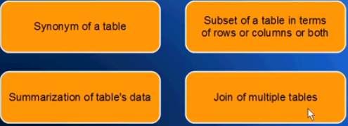
Views

Slide 20
View Definition
A relation that is not of the conceptual model but is made visible to a user as a “virtual relation” is called a view.
A view is defined using the create view statement which has the form
create view v as < query expression >
where <query expression> is any legal SQL expression. The view name is represented by v.
Once a view is defined, the view name can be used to refer to the virtual relation that the view generates.

Slide 21
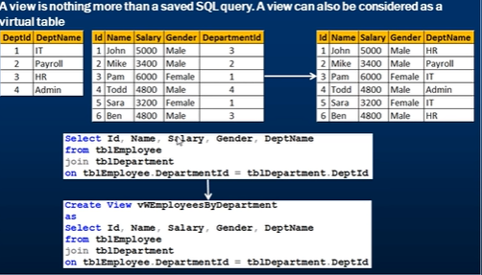

Slide 22
Example Queries
A view consisting of branches and their customers
Find all customers of the Perryridge branch
create view all_customer as (select branch_name, customer_name from depositor, account where depositor.account_number =
account.account_number )
union (select branch_name, customer_name from borrower, loan where borrower.loan_number = loan.loan_number )
select customer_name from all_customer where branch_name = 'Perryridge'

Slide 23
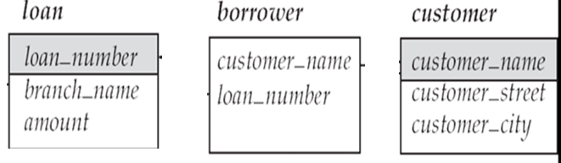
Why do we need Views?
We want to hide some information from some users
Consider a user who needs to know a customer’s name, loan number and branch name, but has no need to see the loan amount.
Define a view (create view cust_loan_data as select customer_name, borrower.loan_number, branch_name from borrower, loan where borrower.loan_number = loan.loan_number )
Grant the user permission to read cust_loan_data, but not borrower or loan
Predefined queries to make writing of other queries easier
Common example: Aggregate queries used for statistical analysis of data

Slide 24
Can we update a View (like table)?
For some DBs yes, for some no
Create a view of all loan data in the loan relation, hiding the amount attribute
create view loan_branch as select loan_number, branch_name from loan
When you want to add a new tuple to a view
insert into loan_branch values ('L-37‘, 'Perryridge‘)
This insertion must be represented by the insertion of the tuple
('L-37', 'Perryridge', null )
into the loan table

Slide 25
Then, when can’t I insert into a view?
Some updates through views are impossible to translate into updates on the database relations
create view v as select loan_number, branch_name, amount from loan where branch_name = ‘Perryridge’
insert into v values ( 'L-99','Downtown', '23')
Others cannot be translated uniquely
insert into all_customer values ('Perryridge', 'John')
Have to choose loan or account, and create a new loan/account number!
Most SQL implementations allow updates only on simple views (without aggregates) defined on a single relation

Slide 26
OUTLINE
SQL
Ordering
Set Operations
Inner Join/Left Outer Join/Right Outer Join/Full Join
Aggregate Functions
Modifying the database (Delete/Insert/Update)
Views
Stored procedures
Functional Dependencies
Normal Forms

Slide 27
Stored Procedures
Stored procedures reduce the traffic between application and database server because instead of sending multiple uncompiled long SQL commands statement, application only has to send the stored procedure name and get the result back.

Slide 28
Advantages of Stored Procedures
Stored procedure is reusable and transparent to any application which wants to use it. Stored procedure exposes the database interface to all applications so developer doesn’t have to program the functions which are already supported in stored procedure in all programs.

Slide 29
More advantages
Stored procedure is secured. Database administrator can grant the right to application without granting any permission on the underlying database table.

Slide 30
Disadvantage of stored procedures
Stored procedure make the database server high load in both memory for and processors.A programmer could be asking the database server to perform a number of logical operations or a complex of business logic which is not the role of it.
Stored procedure only contains declarative SQL so it is very difficult to write a procedure with complexity.
You cannot debug stored procedure.
Writing and maintaining stored procedure usually requires specialized skill set that not all developers possess.

Slide 31
Creating MySQL Stored Procedures
Click your database(i.e. bank) on MySQL
You may either
right click the “Routines” option and pick “Create procedure” and continue
Or you may directly execute the code below:
DELIMITER $$
CREATE PROCEDURE `bank`.`getallaccounts` ()
BEGIN
Select * from account;
END $$
DELIMITER ;

Slide 32
Calling the stored procedure
Now you may retrieve all accounts from the database by :
Call getallaccounts();

Slide 33
Declaring and assigning variables
Variables are used in stored procedure to store the immediate result. You can declare a variable by the following syntax:
DECLARE variable_name datatype(size) DEFAULT default_value;
i.e.
DECLARE total_accounts INT DEFAULT 0
Using set to assign value to variables
DECLARE total_accounts INT DEFAULT 0
SET total_accounts = 10;
Using select to assign value to variables
DECLARE total_accounts INT DEFAULT 0 SELECT COUNT(*) INTO total_accounts FROM accounts

